Slide 1
Climate Change
Are you able to survive?

Slide 2
Introduction
It’s pleasantly warm outside. The average temperature is pretty nice, bur there are some colder or warmer areas around, so the world to is divided in four habitats.
Four feline species are occupying the arid environment, perfectly adapted to their habitat. Life is easy.
But every now and then the climate changes. When the temperature drops, the ice grows, while when it increases the arid region expands. Species need to adapt quickly or they will get extinct.
Does your species have what it needs to survive?

Slide 3
Contents
5 climate sheets for temperature 1 to 5 (from the coldest to the warmest).
4 species figurines
16 tokens (4 for each habitat)
X mutation cards (10? +1 each gene, 10 - 1 each gene, 30 fun facts)
4 Genomes tables
Patafix
1 dice

Slide 4
Preparation
4 players, each of them is a species. Each player gets:
A species figurine
A yellow token
A genome containing three genes: size, metabolism and colour.
Something to mark the adaptation on the genome board. At the beginning those have to be put on 5, as it is the one associated to yellow.
Two mutation cards.
Put on the table climate board number 3 and place each species in a yellow cell of choice. Cells cannot be shred between players.

Slide 5
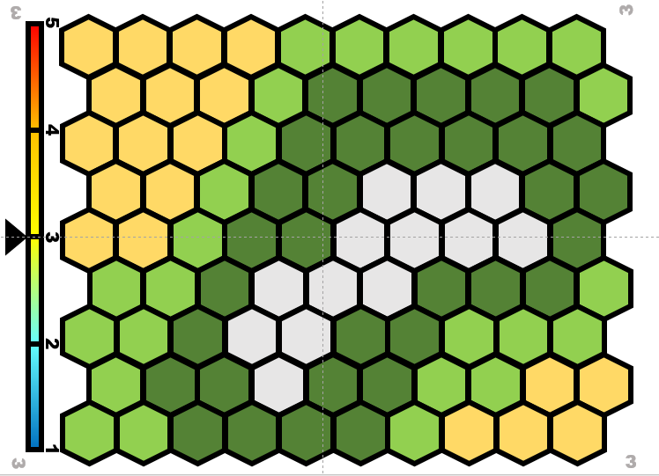
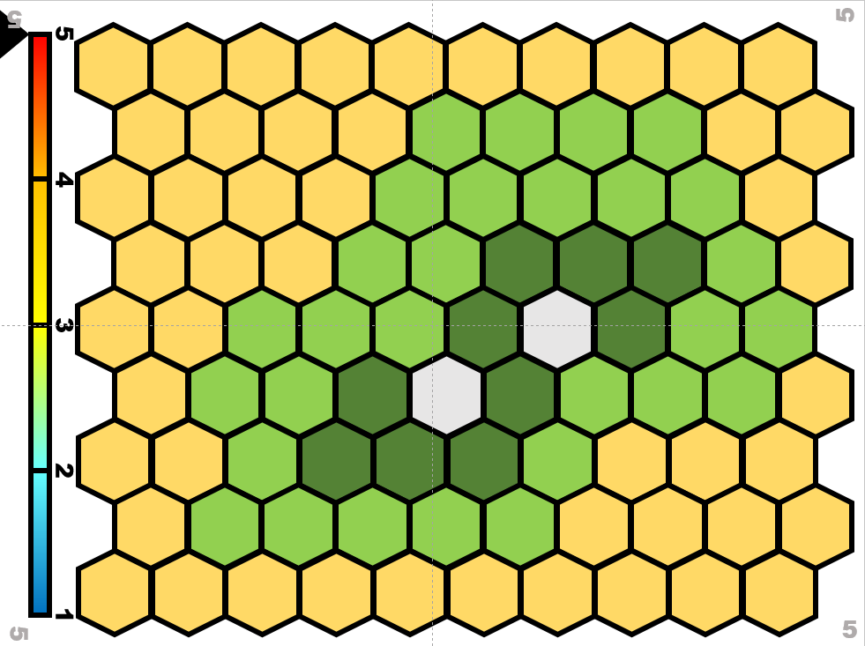
Board: Habitats
There are 5 levels of temperature (bar on the left) each one associated to a specific combination of 4 habitats. Their proportions on the board are based on the overall level of temperature.
Ice: cold and dry, no vegetation
Steppe: cold and humid, few trees
Forest: warm and humid, only trees
Arid: warm and dry, not much vegetation
The game starts from board 3, with each player in a cell of choice within the arid habitat. It is not possible for two or more species to share a cell.
steppe
ice
forest
arid

Slide 6
How does it work? Adaptation
Can species live everywhere? No! Their genome (DNA) has specific gene variants allowing each of them to live in a specific habitat, i.e. being adapted to it.
The genome of each species contains three genes coding for fur colour, metabolism, and shape/size of the body. Each gene can be present in four variants (1-4) each of them associated to an habitat.
In order to survive in any given environment the species must possess at least two of the gene variants associated to the habitat itself. It is possible to adapt to new habitats by having new mutations, i.e. using mutation cards for the relevant gene to change its value.

Slide 7
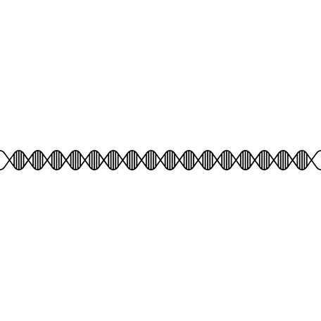
Genome board description
CATGAATATTGTACGGTACCATAAATACTTGACCACCTGTAGTACATAAAAACCCAATCCACATC
3 Genes:
Four variants (=values) for each of them, each allowing adaptation to a specific habitat: from 1 (adapted to ice) to 4 (adapted to arid).
A little SOMETHING marks the current level of adaptation.
The value can be changed using the mutation cards (+/-1) associated to each gene. Some cards are neutral, i.e. do not change the value of any gene.
GENOME BOARD
 | COLOR | BODY | METABOLISM
4 | Yellowish | Big and skinny | Fast
3 | Spotted | Medium and skinny | Quite fast
2 | Grayish | Medium and robust | Quite slow
1 | White | Small and chubby | Slow
steppe
ice
forest
arid

Slide 8
-1
-1
-1
ACTTGACCACCTGTAG
ACTTGACCACCTGTAG
ACTTGACCACCTGTAG
ACTTGACCACCTGTAG
ADAPTATION CARD
BODY
ADAPTATION CARD
COLOR
ADAPTATION CARD
METABOLISM
Fun fact about felines, climate change etc.
+1
+1
+1
ACTTGACCACCTGTAG
ACTTGACCACCTGTAG
ACTTGACCACCTGTAG
NEUTRAL CARD
FUN FACT
ADAPTATION CARD
BODY
ADAPTATION CARD
COLOR
ADAPTATION CARD
METABOLISM

Slide 9
How to play
At each turn the player picks a mutation card (to be kept covered) and rolls the dice. If the player has more than 8 cards one at random must be discarded (put at the bottom of the discarded pile)
If the value of the dice is between 1 and 3 the species stays where it is, and the turn goes to the next player.
If the value of the dice is between 4 and 6 the species has to move to a neighbouring unoccupied cell of choice.
When the species want to move to a different habitat it needs to adapt, i.e. have the value associated to the new habitat in at least two genes. Such values are changed using mutation cards (specific for each gene) giving +1 or -1 as needed.
Each time a card is used it is put back in the discarded pile. Each time a new habitat is occupied, a token is given to the player. When there are no more cards available the discarded pile is shuffled and put back as MAZZO.

Slide 10
Climate change
At the end of each round the dice must be thrown. If it makes 1 or 6 the climate changes. A second roll of the dice tells if the climate goes one step down (1-3) or up (4-6).
If the climate is already 1 or 5 it can only go respectively up and down. Then the board is changed to the relevant new one.
After the climate change, each player that rolls a 1-3 either is adapted to the cell it is in, or should adapt to it with the DNA cards. If it is not possible to adapt the species get extinct (see next slide).
If the player rolls 4-6 he/she can move two steps instead of one, and needs to be adapted or to adapt to the new location to not get extinct.

Slide 11
Extinction
If the species find itself in an habitat to which it is not possible to adapt (e.g.no cards available to allow correct adaptation) it get extinct.
When a species get extinct it gives back all cards and tokens but the yellow one. It then moves to a yellow cell of choice and gets two new cards.

Slide 12
Aim of the g ame
forest
arid
steppe
ice
Wins the game the player that collect all 4 habitat tokens

Slide 13
1
1
5
4
3
2
1
1
1

Slide 14
2
2
5
4
3
2
1
2
2

Slide 15
3
3
5
4
3
2
1
3
3

Slide 16
4
4
5
4
3
2
1
4
4

Slide 17
5
5
5
4
3
2
1
5
5

